Slide 1
CS391 Project Description Team 3
Kaan Apak, Ezgi Maden, Muratcan Kılıçcı, Ece Kamburoğlu, Asena Ayşe Gevşek
Lecturer: Esma Meral

Slide 2
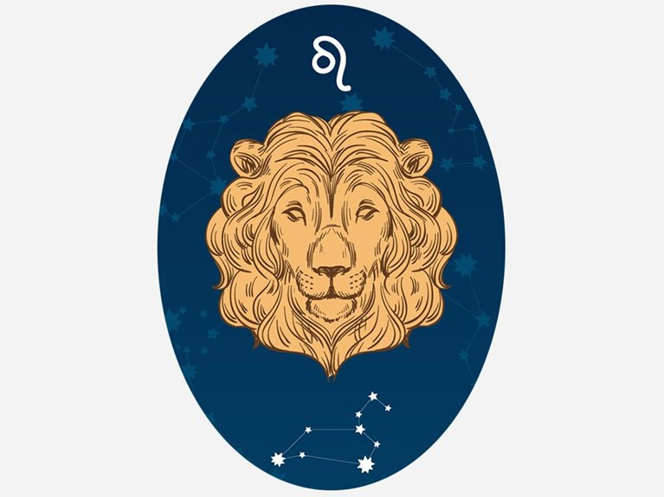
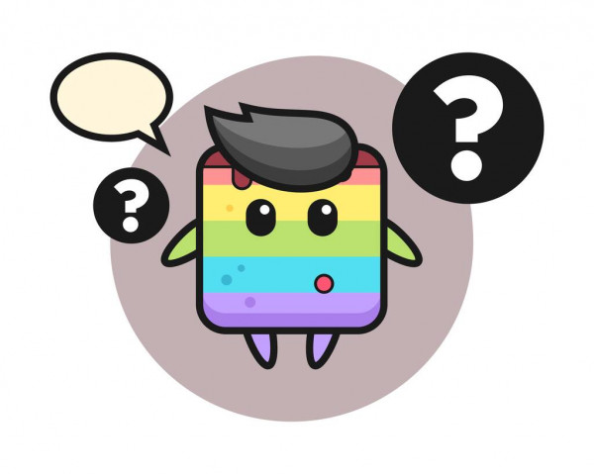
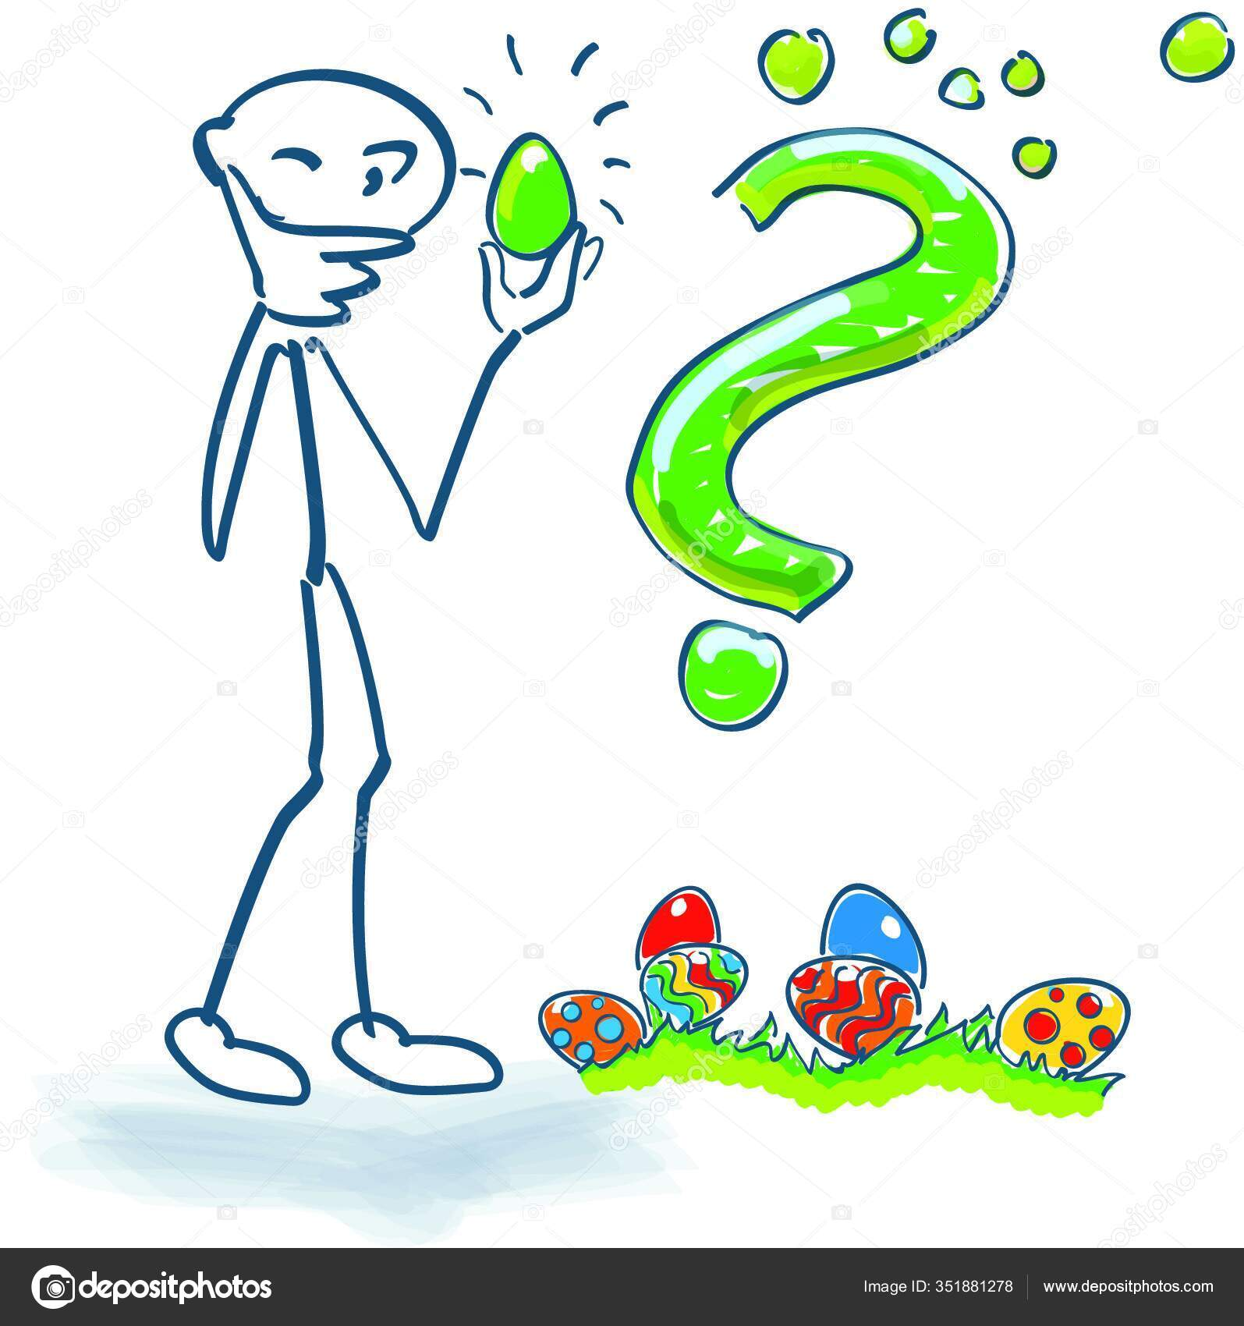
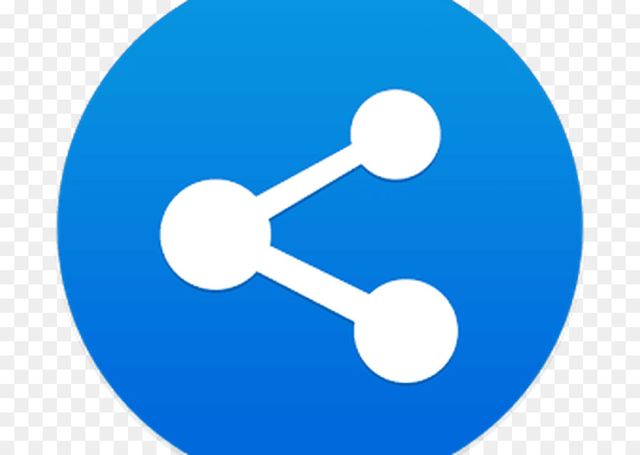

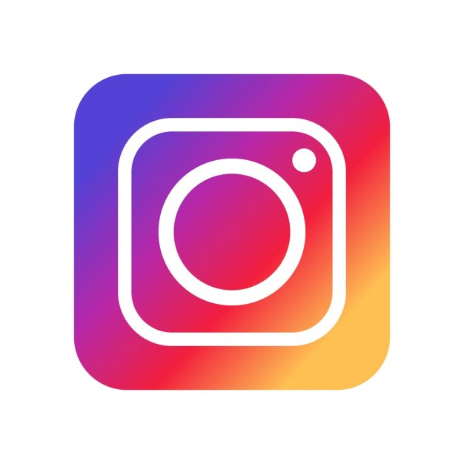


Main Page
Main page
Horoscopes
Tests
Login
Sign in
Our logo
Advertisement
Places You Should Visit In İstanbul After the Pandemic
Did you know…?
Top 10 Movies You Should Watch Before You Die
Footer: Our team

Slide 3
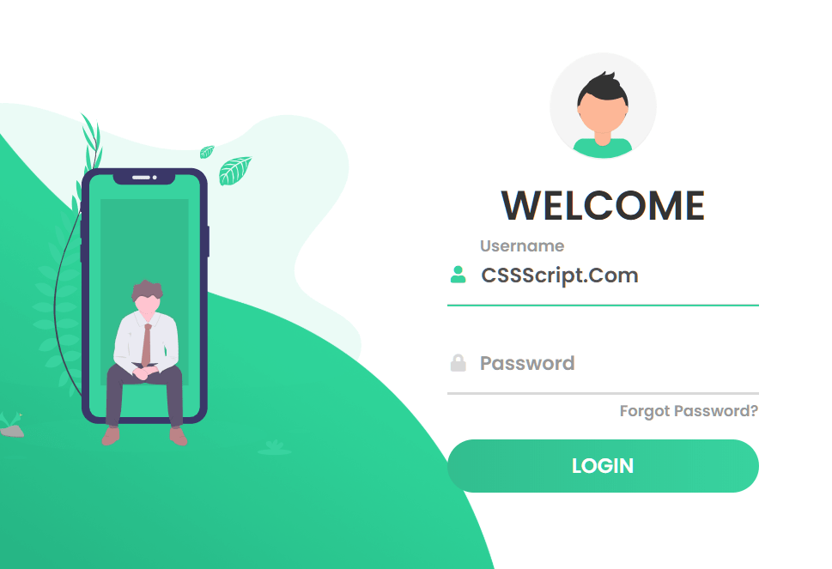
Login Page
Main page
Login
Sign in
We will design a page like this, the icon (avatar) will change according to the user’s gender
Remember me button (webstorage API)
Footer: Our team

Slide 4

Sign Up Page
Main page
Login
Sign Up
Form:
Username
Email
Password
Passwrod (again)
Birthday
Gender Identity
Footer: Our team

Slide 5
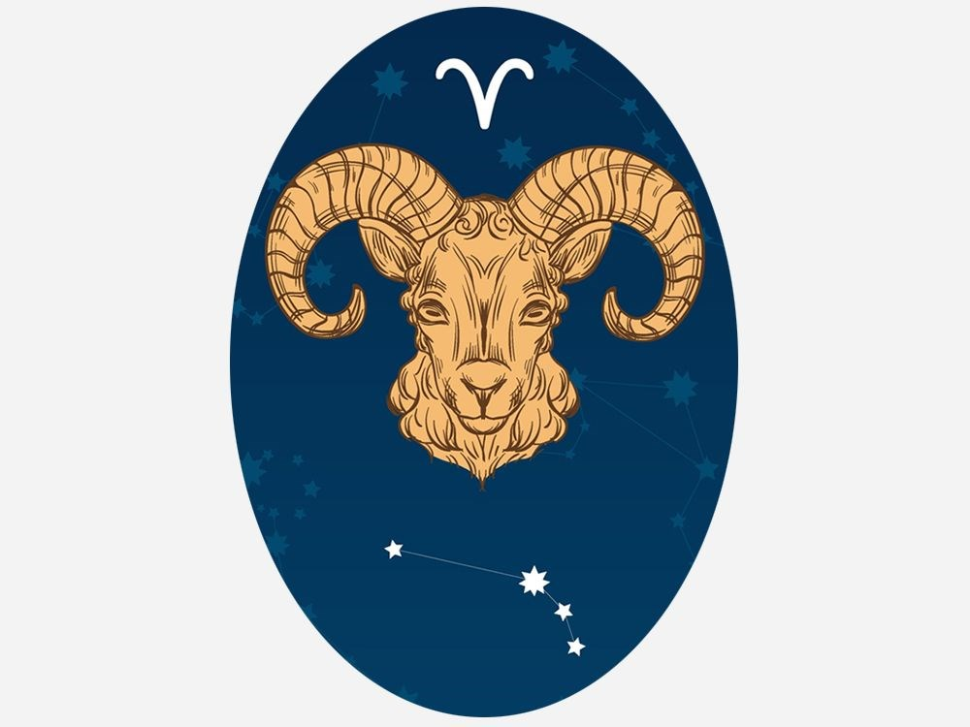
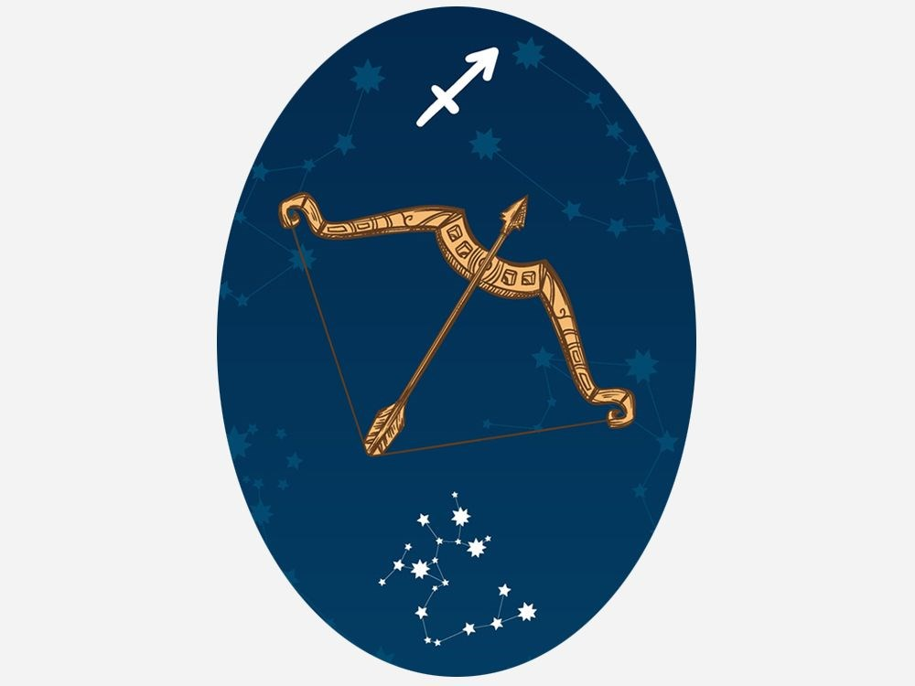
Horoscopes Page
Main page
Horoscopes
Tests
Welcome username
Our logo
Did you know…?
Muratcan’s horoscope comments for each horoscope
Advertisement
Footer: Our team

Slide 6
Tests Page
Main page
Horoscopes
Tests
Welcome username
Our logo
Did you know…?
Picture about test
Test 1 (like onedio tests)
Test 2 (like onedio tests)
Advertisement
Picture about test
Footer: Our team

Slide 7
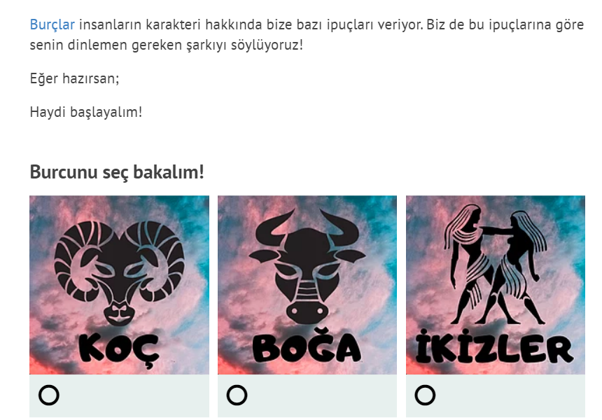
Sample Test Page
We will have test pages (questions and multiple choice answers) like the given sample
Main page
Horoscopes
Tests
Welcome username
Our logo
Did you know…?
Advertisement
Footer: Our team

Slide 8
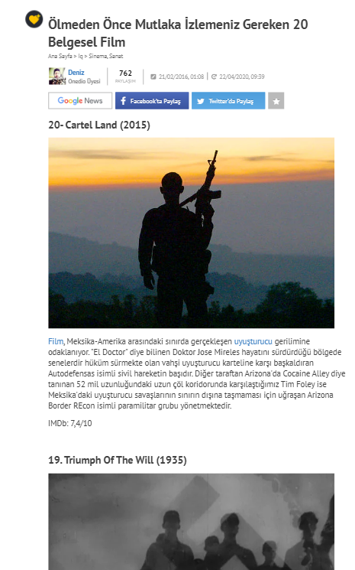
Sample for Links in the Main Page
We will do a design like this for links in the main page

Slide 9
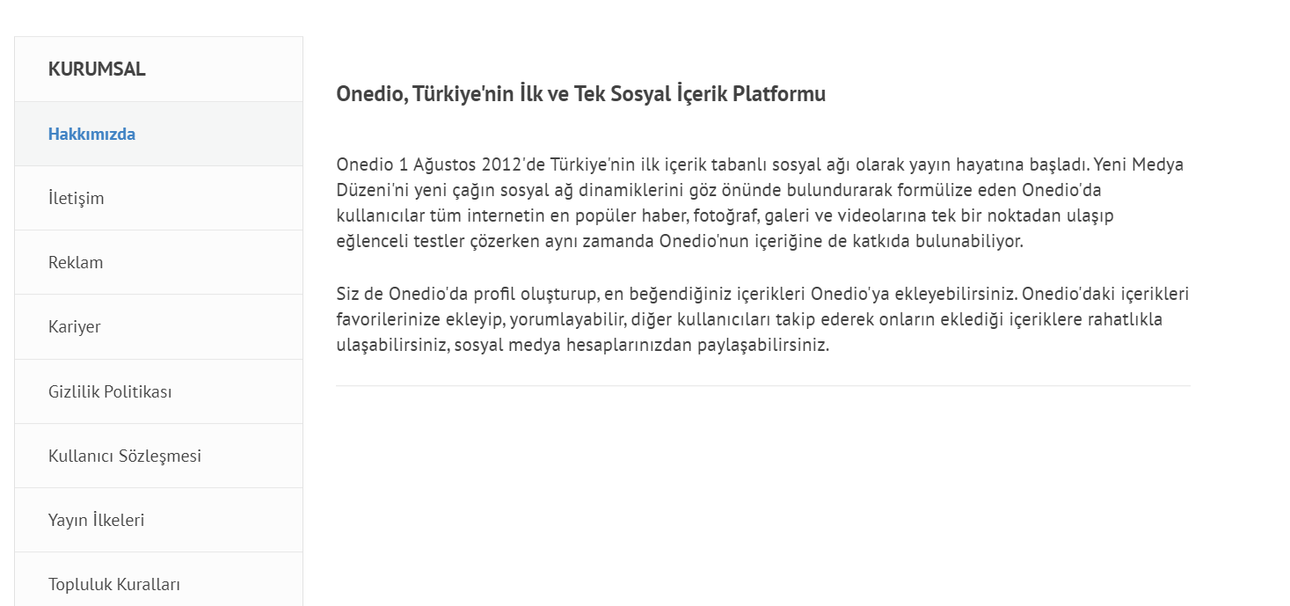
Our Team Page
We will have a page like this which will introduce our team members

Slide 10
Sources
https://www.ntv.com.tr/galeri/astroloji-ve-burclar/gunluk-burc-yorumlari-17-nisan-2021,eh2HmJRYpEOkDc_Kp6TVYQ/esKPXy1YdU2J-aIe9mMszw
https://images.app.goo.gl/KtuYxzCdskMtpEP87
https://images.app.goo.gl/eJFAKyLXTnuXHX7DA
https://images.app.goo.gl/EZ272NMHGjQhJK479

